Slide 1
Ian Kyle
Children’s Planning Manager, The Highland Council

Slide 2
In addition to organising this event in the last 8 months Kirsty Baird, Highland Councils Health Development Officer and Eve MacLeod, NHS Highland's Health Improvement Specialist for tobacco, alcohol and drugs, have been;
Updating the Highland Substance Awareness: Prevention and Education Framework
Developing and piloting lesson plans to accompany the 3-18 Framework
Updating the H-SAT to ensure relevant and up to date materials are available for young people, parents and cares, and professionals.

Slide 3
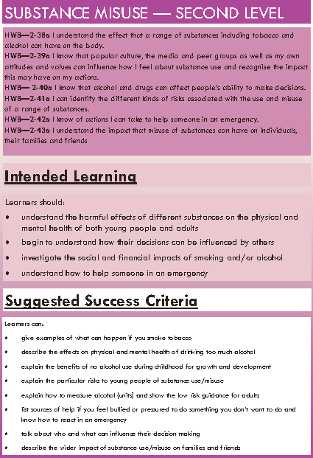
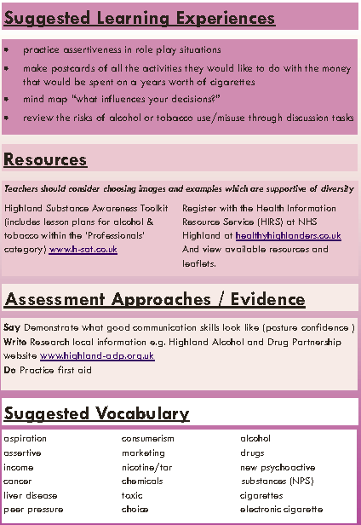

Slide 4
Thanks to….. For their time to prioritise and pilot lesson plans, and provide feedback. This has been really useful to develop lesson plans which are now available on the H-SAT. - We had over 250 children and young people feedback on the lessons. - 94% of C&YP stating they learned ‘a little’ or ‘a lot’ in the lesson. You will participate in an example lesson during the blue workshop today.
• Crown Primary
• Hilton Primary
• Milton Primary
• Farr High School
• Thurso High School
• Plockton High School
• Kinlochbervie High School
• Youth Highland
• Action for Children
• Highlife Highland

Slide 5
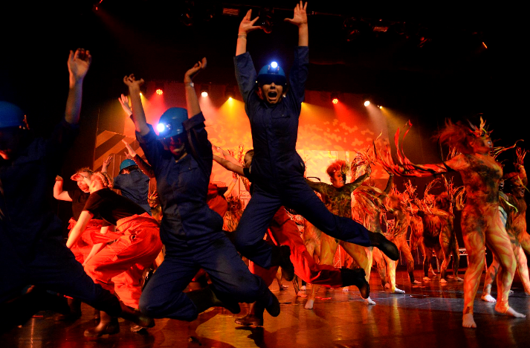
SAS Award
Launch of the Highland Substance School Award.
The Substance Aware School (SAS) Award has been developed to recognise and reward consistent, ongoing approaches to prevent substance use among young people across the Highlands.
This initiative is a joint partnership between the Highland Alcohol and Drugs Partnership (HADP), the Highland Council, NHS Highland, and Police Scotland.

Slide 6
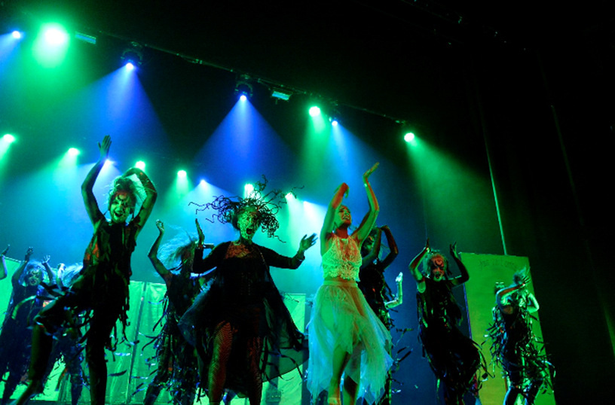
By sponsoring this award we aim to:
•Support and promote evidence informed substance education and prevention in the Highlands
•Celebrate and showcase good practice of substance education and prevention in the Highlands
•Encourage and sustain healthy attitudes and behaviours among young people in the Highlands

Slide 7
We encourage external partners to assist with the development of substance education within schools and with applications, which are available through H-SAT.
The 2018/2019 SAS Award will be presented to three successful applicants on a tiered basis. Successful applicants will receive funding to spend on further substance education and prevention approaches, such as positive or diversionary activities, or family centred activities.
Gold SAS Award winners will receive a prize of £1,000
Silver SAS Award winners will receive a prize of £500
Bronze SAS Award winners will receive a prize of £250
Successful applicants must plan an evaluation of their activities, for example describing the three main benefits of the activities, and who they would benefit (e.g. young people, parents / carers, the local community).

Slide 8
Applications are welcome from all schools
Successful applications will achieve the following criteria:
Demonstrate how the Highland Substance Awareness: Education and Prevention Framework has informed substance prevention and / or education (e.g. use of accompanying lesson plans)
Describe ways in which the Highland Substance Awareness Toolkit (H-SAT) has been accessed, utilised, or promoted
Develop or review the school substance policy, ensuring it is up to date and complied with
Encourage, support, or provide positive / diversionary activities

