Slide 1
Debbie Stewart
Co-ordinator
www.highland-adp.org.uk
deborah.stewart@nhs.net

Slide 2
Have you heard of the HADP?
Yes
No
Split

Slide 3
Partnership Working
Prevention Recovery
Enforcement
Treatment
Family support
Whole population approaches
Children affected by parental misuse
Mutual Aid
Early years support
Community Development
Positive activities
Peer support
Harm reduction
Challenging Stigma
Social marketing
Education & Prevention
Employabilty
Criminal Justice
Service user involvement
Notes:
ed.

Slide 4
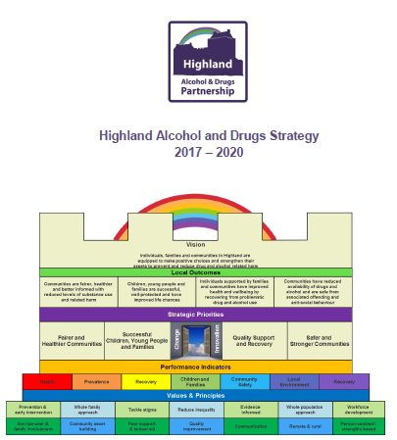
Partnership Priorities
Deliver evidence-informed,
coordinated and family inclusive
education and prevention
programmes in schools and
communities
Increase positive activities
Utilise digital media to
promote informed choices

Slide 5
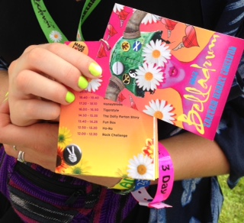
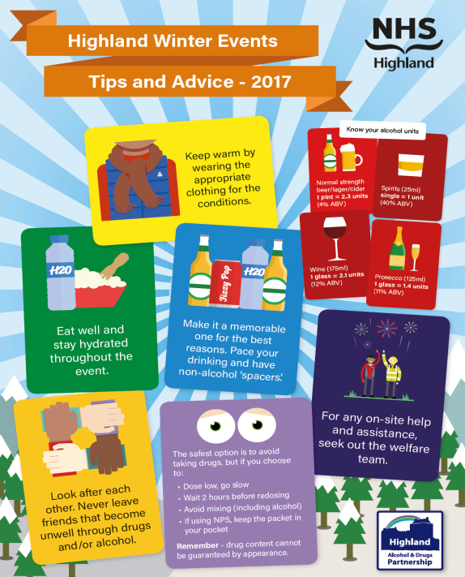
Partnership Activities

Slide 6
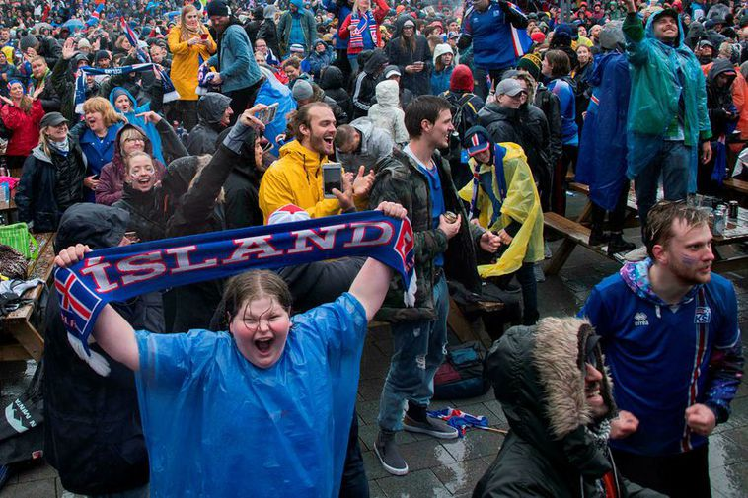
Your View Could Iceland win the World Cup?
Yes
No
Split

Slide 7
Nordic Cousins
"In countries where it's dark half the year,… we share quite a dark sense of humour , a feeling that the world's messed up, and we might as well laugh about it”.
Ian Rankin, Writer
"There are so many similarities, especially in terms of our relationship to nature - the oil, the fisheries, the fish farming, the renewables. There are so many parallels”.
Dr Arne Kruse, University of Edinburgh
"It's like two cousins who have gone their own ways - only one of them still has his own hair, but they're still cousins. We should seek to learn from our cousins”.
Lesley Riddoch, Columnist

Slide 8
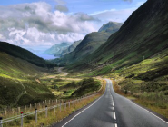
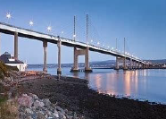
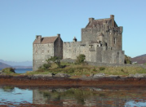
Scots and Norse
Wick (inlet/bay)
Dingwall (assembly field)
Tongue (split of land)
Busby (bush by farmstead)
Greet (cry), Keek (look),
Dook (dive), Bairn (child),
Ken (to know), Muckle (much),
Kilt (to fold/tuck), Hame (home),
Stovsuger (hoover)

Slide 9
Icelandic Model
Iceland has radically cut teenage
smoking, drinking and drug use in the
past 20 years
Mosiac, 2018
“The main principle is that drug education
[alone] doesn’t work. What is needed are
the life skills to act on the information”
Professor H Milkman,
Reykjavik University
Notes:
.

Slide 10
Protective Factors
Peer group
Friends that don’t use
Not involved in risky behaviours
Family
Parental support and monitoring
Model sensible behaviour
Clear rules / boundaries
Social Capital
Positive/recreational activities
Inclusive school
Positive relationships
Reduced access / acceptance of substances
Network of support

Slide 11
Icelandic Model
Changing the law
Parental ‘pledge’
Keeping young people occupied
Evidence- informed
Political support

Slide 12
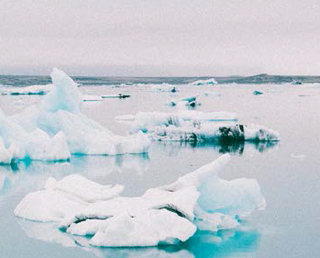
Your View Could the Icelandic model be adapted and work in Highland?
Yes
No
Split

Slide 13
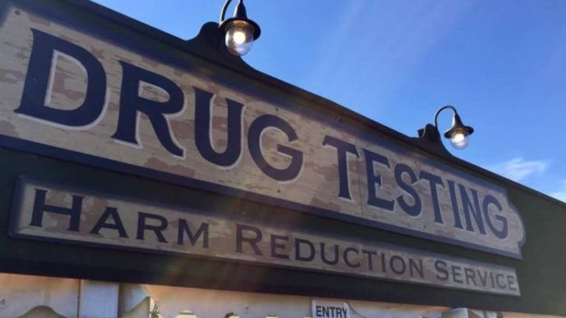
Your View Drugs safety testing at festivals would reduce harm and save lives?
Yes
No
Split

Slide 14
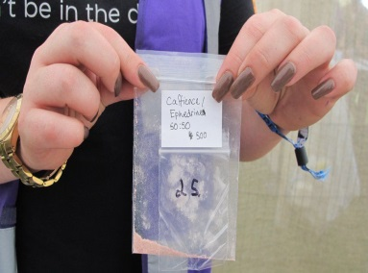
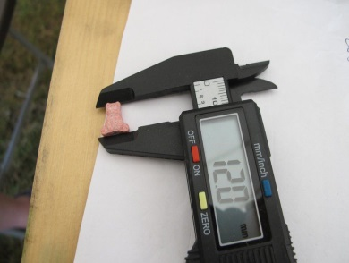
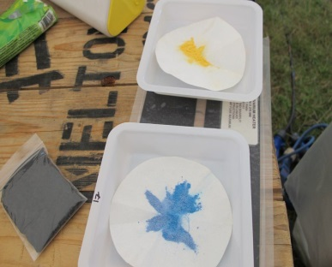
Drugs Safety Testing at Festivals
When asked:
Festival goers would be supportive
Drug using festival goers would use service
Provides opportunities to:
Intervene early
Highlight onsite drug content
Inform welfare and medical support
Reduce hospitalisations
Alter drug using behaviours
Raise awareness of adulterated substances
Deliver harm reduction advice / brief interventions
Promote informed choices
Tailor public health and safety messages
Dispose of drugs
The Loop recommend drug safety testing facilities at all UK festivals that adhere to international protocols and good practice guidance to inform best practice

Slide 15
Going Forward
Toolkit - Use and help build
SAS award
Coordinated / integrated approach
Partnership working
Evidence-informed (Mentor resources)
Strengthen protective factors
Parental/community involvement
Positive activities
Targeted / high risk approaches
Progressive / innovative

Slide 16
Your View I plan to use the Substance Awareness Toolkit?
Yes
No
Split

