Slide 1
Preventing Substance Use Among Children & Young People
NHS Highland
Thursday 21st June 2018
Heather McVeigh & Ben Thurman

Slide 2
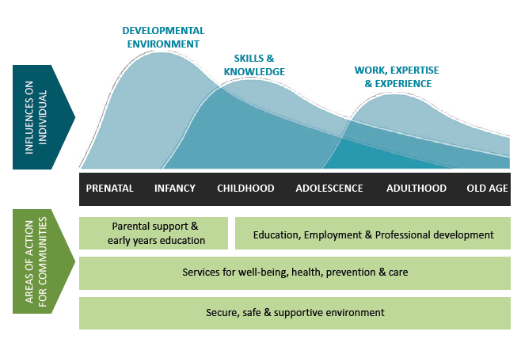
Mentor’s approach to prevention
A holistic, life-course, systemic approach…
…developing life skills that build resilience to risk.
Throughout a young person’s lifetime
https://www.gov.uk/government/publications/cmo-annual-report-2011-volume-one-on-the-state-of-the-public-s-health

Slide 3
Why is school-based prevention important?
Risk-taking behaviour among young people declining at population level.
Underage alcohol consumption and ‘binge drinking’, and problematic alcohol consumption in adulthood remain above European average.
Teenage (and pre-teen) years critically important for influencing long-term behaviours.
Schools provide potential for universal prevention.
Opportunity for learning from peers and reinforcing social norms.
Opportunity for multiple sessions and regular follow-up.
School-based interventions can reduce substance use AND improve attainment, attachment to school and wellbeing.
http://mentor-adepis.org/school-based-alcohol-drug-education-prevention-works/

Slide 4
What works in substance use prevention?
http://mentoruk.org.uk/we-dont-get-taught-enough/
http://www.gov.scot/Publications/2016/12/4388
http://mentor-adepis.org/school-based-alcohol-drug-education-prevention-works/

Slide 5
What doesn’t work
Emphasising harms & fear arousal
Knowledge-based education (relying on information alone)
One-off sessions in isolation, e.g. assemblies
Passive approaches (posters, leaflets, TV adverts)
Use of ex drug users and/or police officers

Slide 6
What the evidence tells us
Approaches based on ‘social influences’ are the most effective at changing young people’s behaviour
Programmes based on life-skills approaches reduce alcohol, tobacco and cannabis use
Interventions developing students’ prosocial skills and emotional intelligence contribute to reducing substance use and violent behaviours and improving academic outcomes
Part of a whole-school approach: delivered through a series of structured sessions, interactive sessions over multiple years by trained teachers

Slide 7
What does this mean for schools & practitioners?

Slide 8
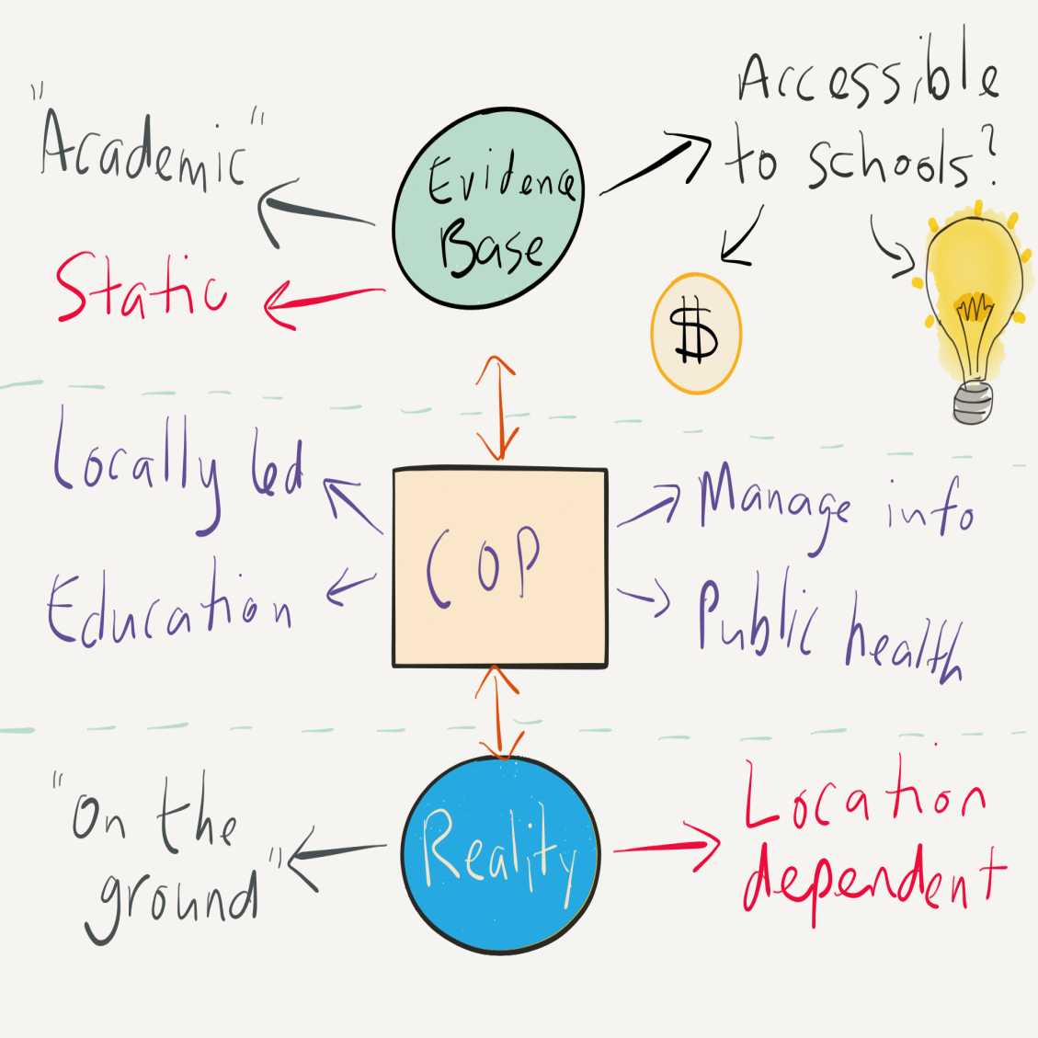
Implementing the evidence base
Big gaps between the evidence base and reality ‘on the ground’.
Share evidence of what works
Develop evidence-based localised approaches
Build ‘Communities of Practice’ to bridge gaps
http://mentoruk.org.uk/we-dont-get-taught-enough/
http://www.gov.scot/Resource/0052/00528562.pdf
https://digitalpublications.parliament.scot/Committees/Report/ES/2017/5/22/Let-s-Talk-About-Personal-and-Social-Education-1#Executive-Summary

Slide 9
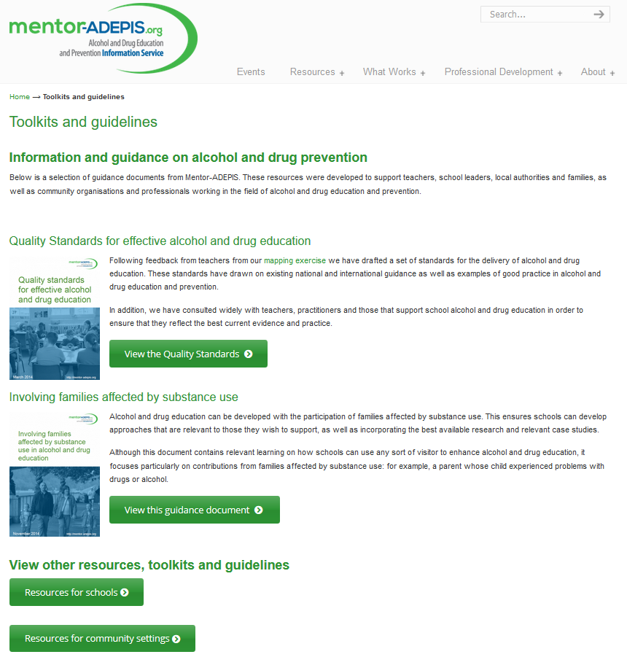
ADEPIS: Alcohol & Drug Education & Prevention Information Service
Launched 2013
Funded by Public Health England & the Home Office
Leading source of evidence-based information and resources for school-based drug prevention
http://mentor-adepis.org/

Slide 10
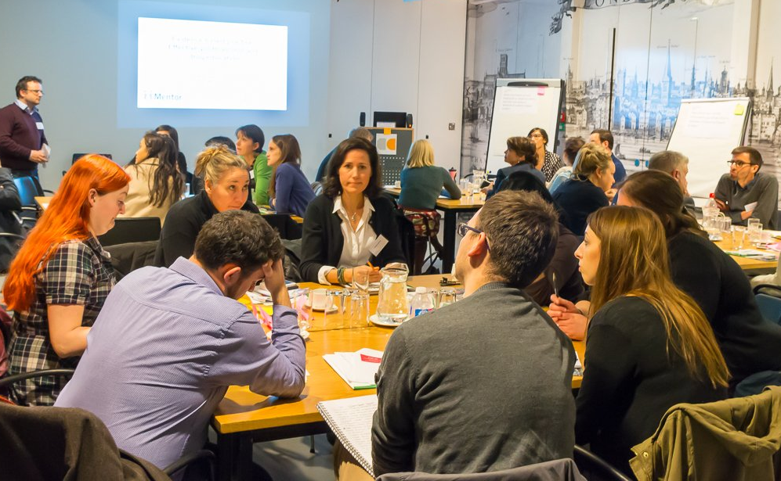
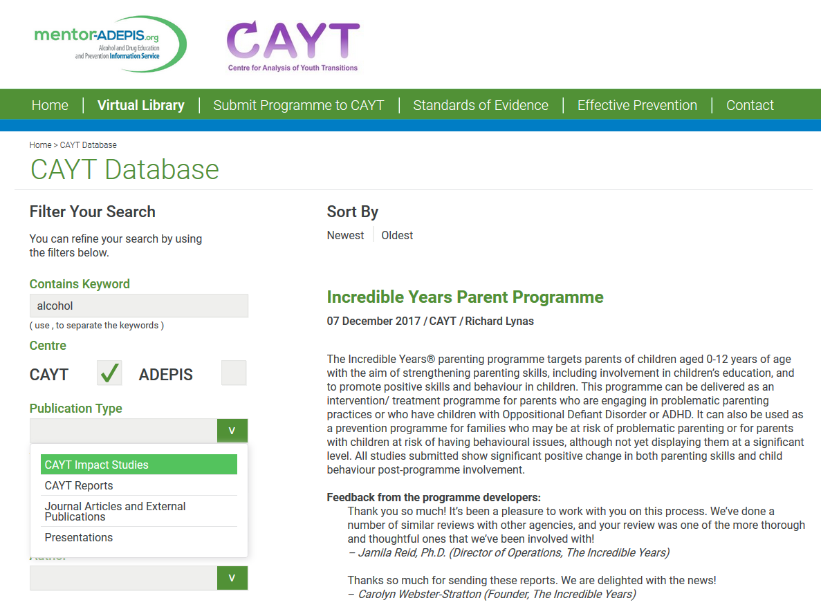
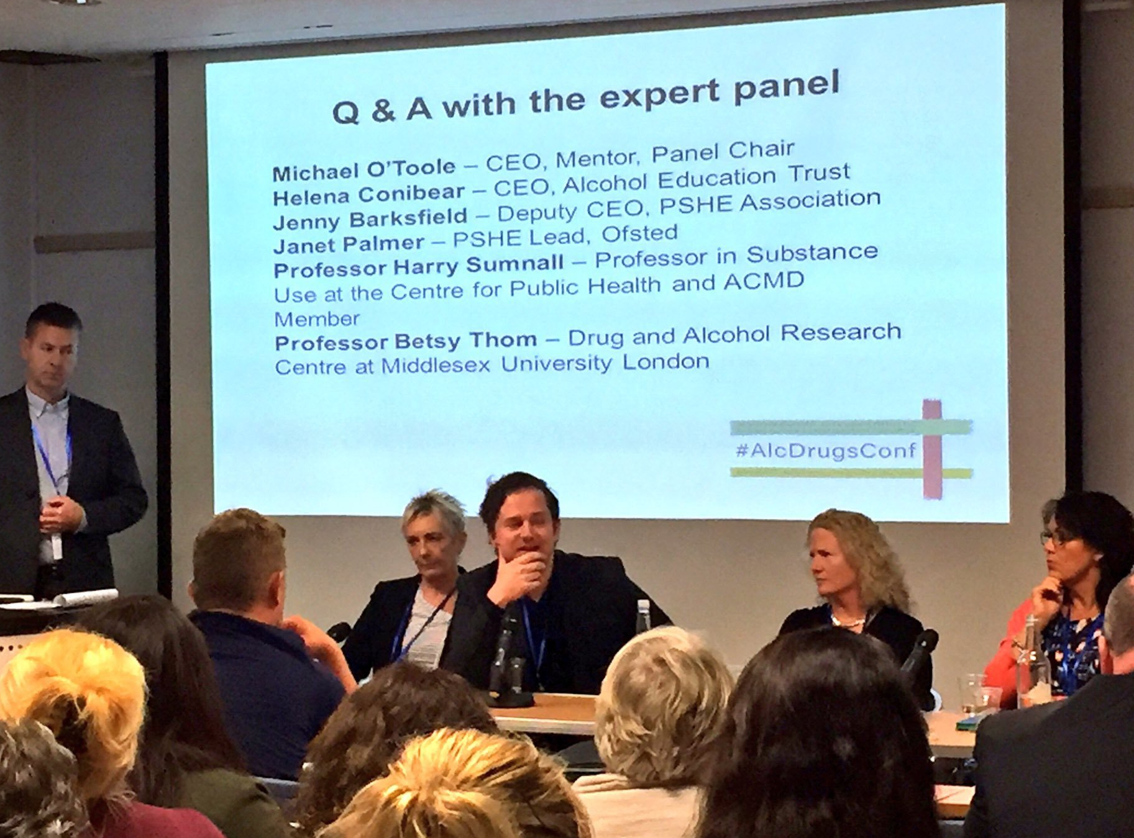

Slide 11
Useful resources
Scottish Government. 2016. ‘What works’ in drug education and prevention?
Scottish Government. 2017. Substance Misuse Education and Prevention in Schools: Rapid Review Mapping Exercise.
Mentor. 2014. Quality standards for effective alcohol and drug education.
Mentor. 2015. ‘We don’t get taught enough.’ An assessment of drug education provision in schools in England.
Mentor. 2017. School-based alcohol and drug education and prevention – what works?
Useful networks
Mentor ADEPIS
Centre for Analysis of Youth Transitions (CAYT)
European Society for Prevention Research (EUSPR)
Stay in touch!
Mentor Scotland
111 Oxgangs Road North, Edinburgh, EH14 1ED
0131 334 8512 | @mentorscotland | mentoruk.org.uk/mentor-scotland
heather.mcveigh@mentoruk.org

Slide 12
Questions for you…
Do you feel confident in delivering evidence-based prevention practice?
What would a Scottish prevention service look like? What are the gaps?

