Slide 1
Alcohol and Units

Slide 2
This formula is used to work out how many units are in a drink

Slide 3
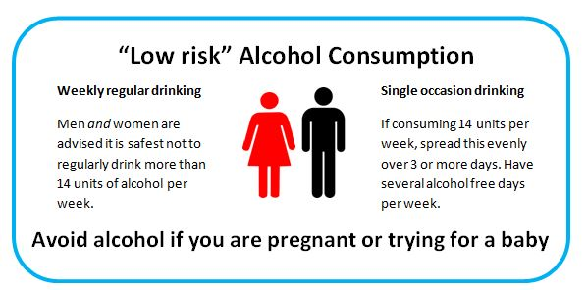
Adults:
Young people?

Slide 4
Why might people chose not to drink?
What might people chose to drink?
If people were going to drink: how much, where, when, who with?

Slide 5
Reasons why people might not want to drink alcohol?
Reasons why people might want to drink alcohol?
If people were going to drink: how much, where, when, who with?

Slide 6
Most interesting point from this session?

