Slide 1
Diamond 9
Lesson 1

Slide 2
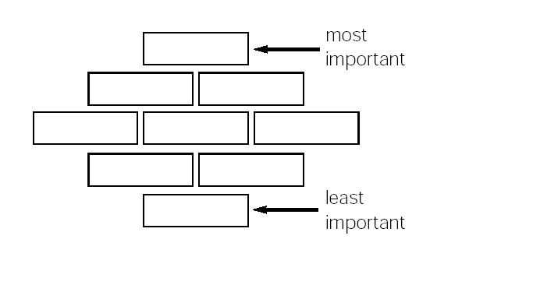
Diamond 9
Choose the most important 9 from the list and then prioritise them in order of what you want to cover, like so:
Notes:
Also supply blank slips so that young people can write down any different issues they want to focus on. There are corresponding lessons aligned with the different example statements. Any others could be researched by the young people and feedback provided in plenary.

