Slide 1
The Drugs Wheel
Senior Level

Slide 2
Three basic drug groups:
Stimulants
Depressants
Hallucinogenics
Notes:
These simple groupings are useful when first learning about substances; however the Drugs Wheel was developed to better categorise different drug types, and their effects, and also harm reduction advice for drug users. Within this model there are 7 categories

Slide 3
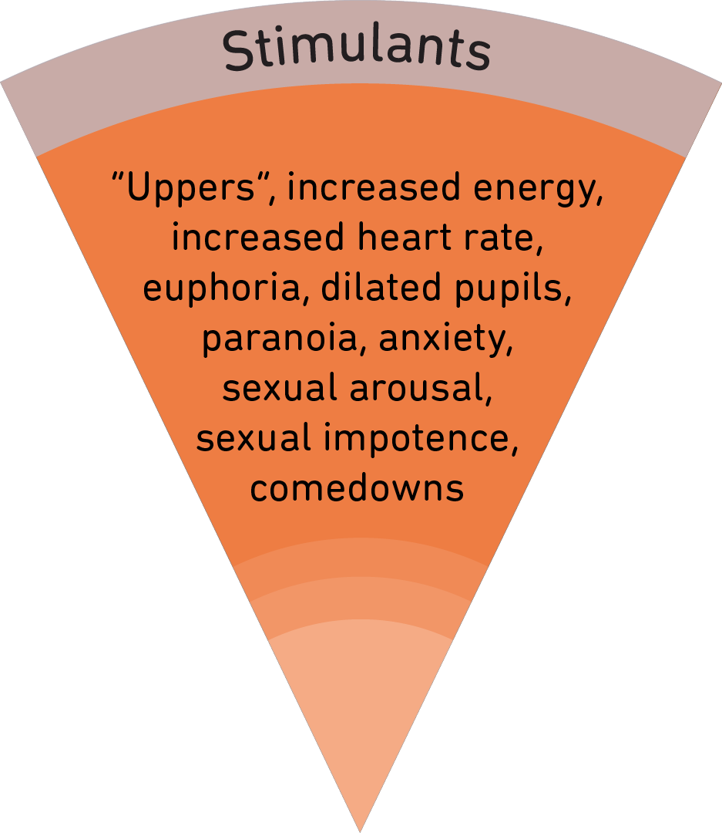
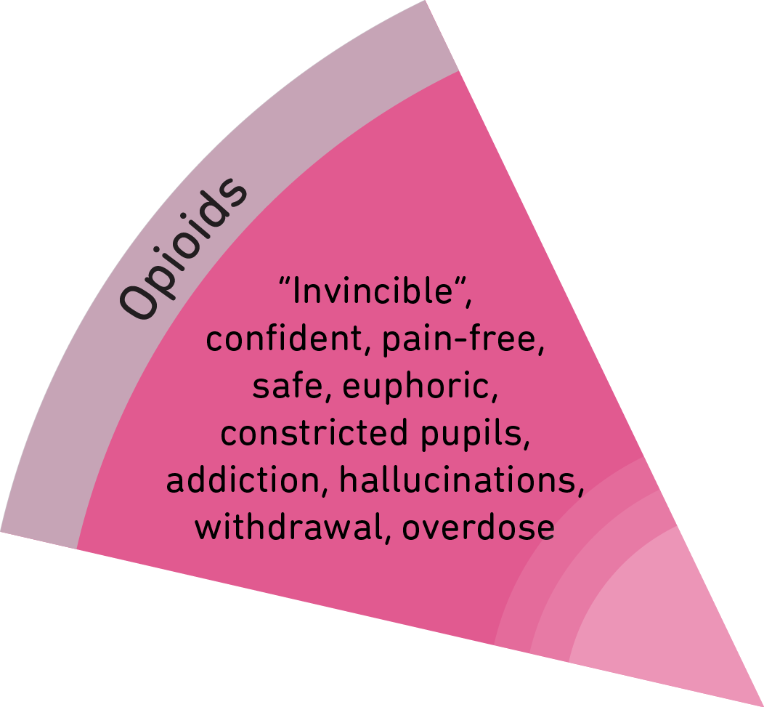
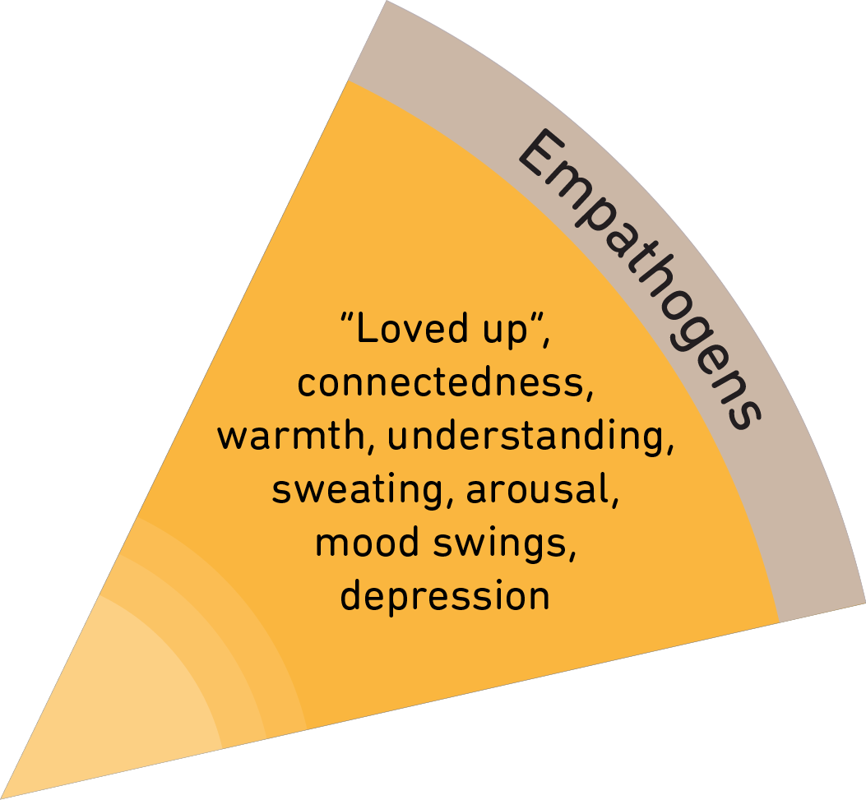
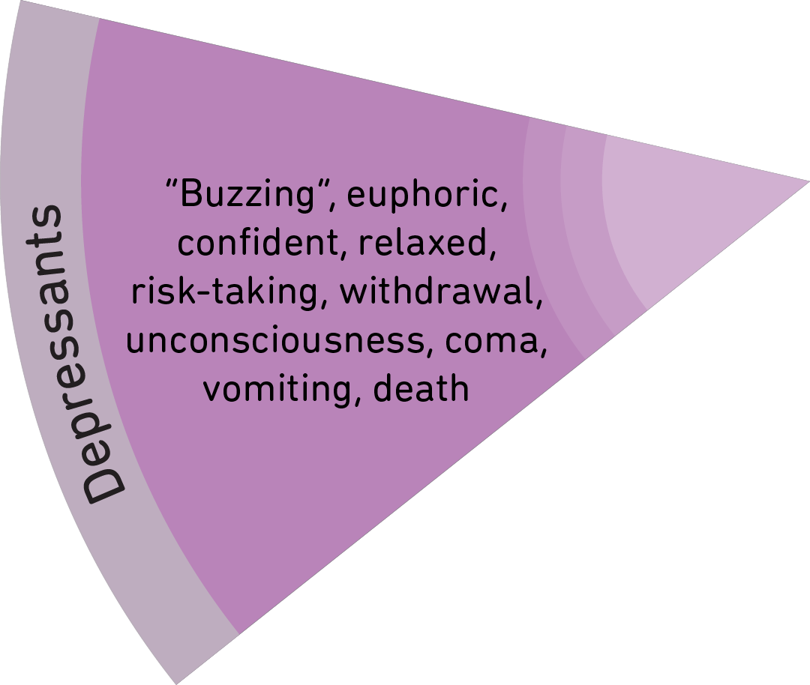
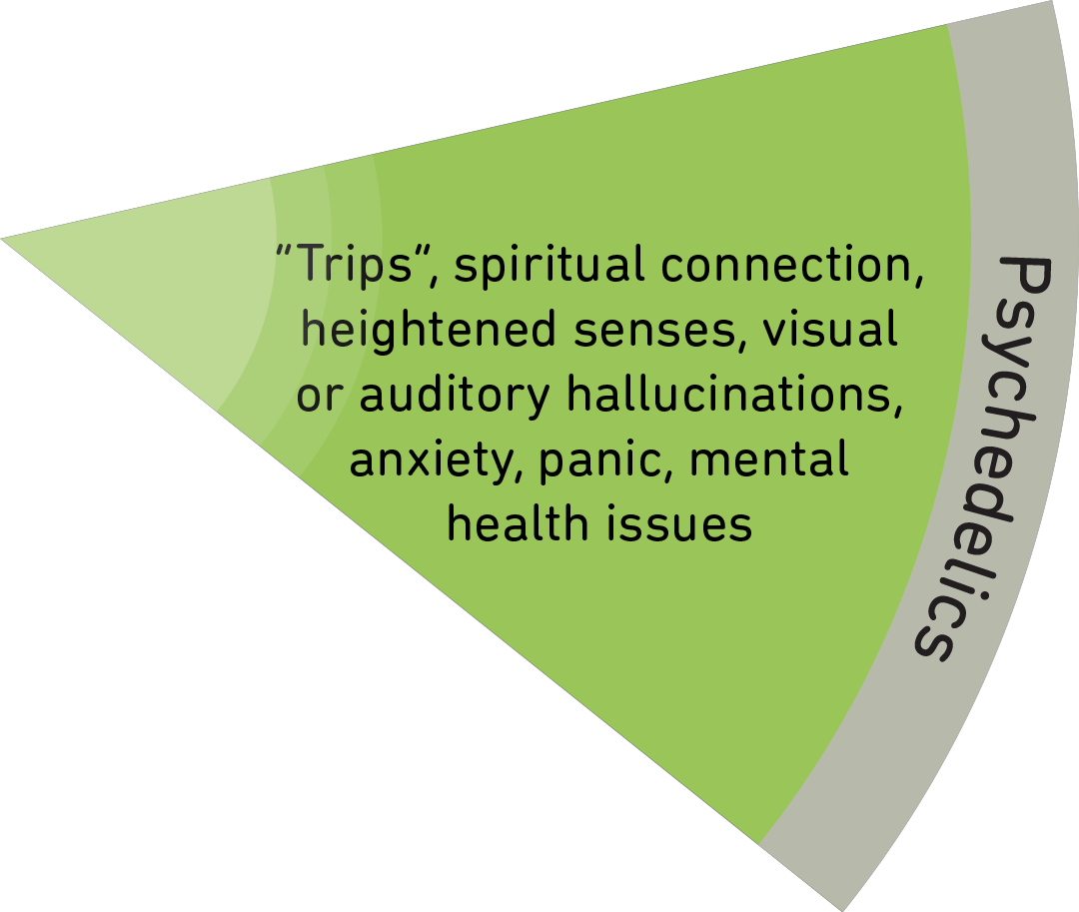
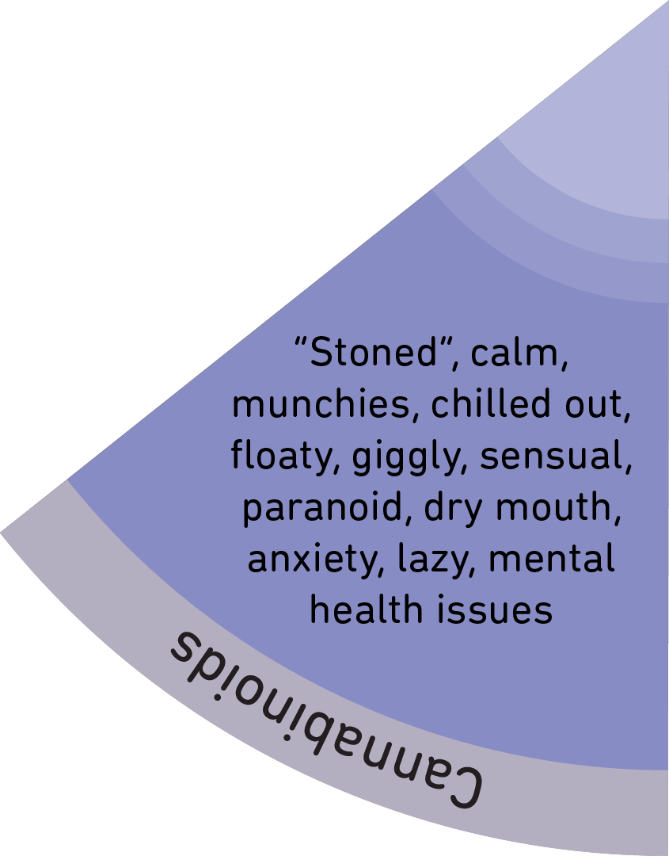
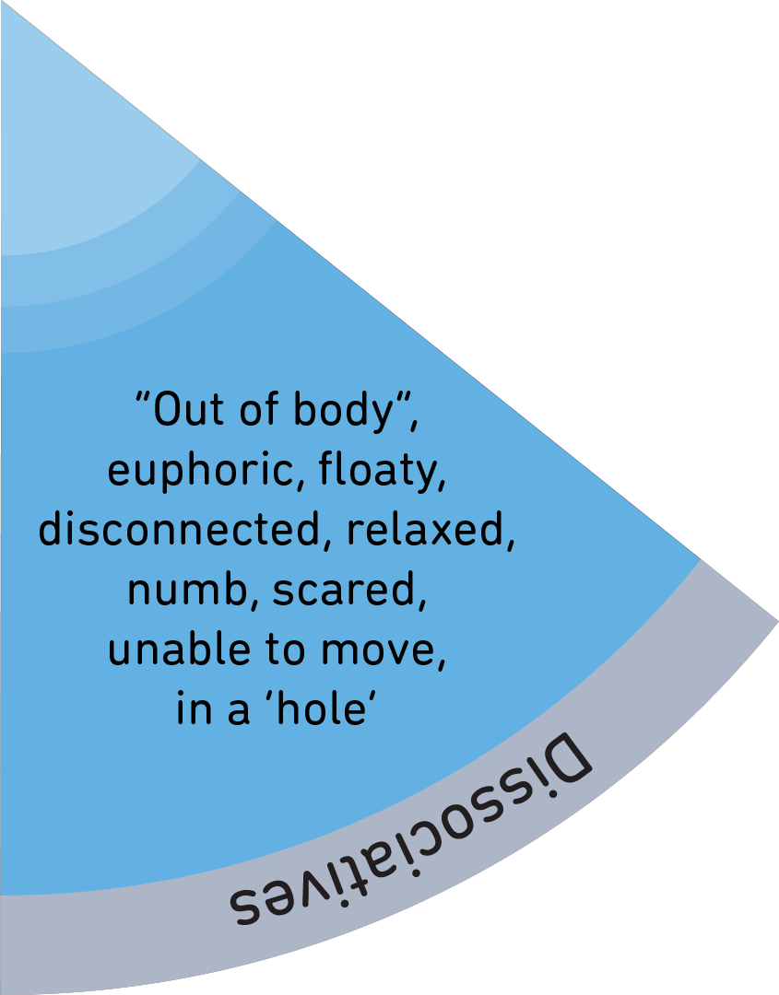
Notes:
Show the Drugs Wheel and it’s 7 categories and examples:
Stimulants
Empathogens
Psychedelics
Dissociatives
Cannabinoids
Depressants
Opioids

Slide 4
Activity
Cut up the segments of the drugs wheel.
Mix them up then place the segments in the correct corresponding section of the wheel.
Repeat the process with the Effects wheel.
Notes:
See Drugs Wheel website for detailed instructions for the games

Slide 5
One thing I have learned from this session is ...

